Slide 1
Software Rasterization
Stanislaw Jaroszynski

Slide 2
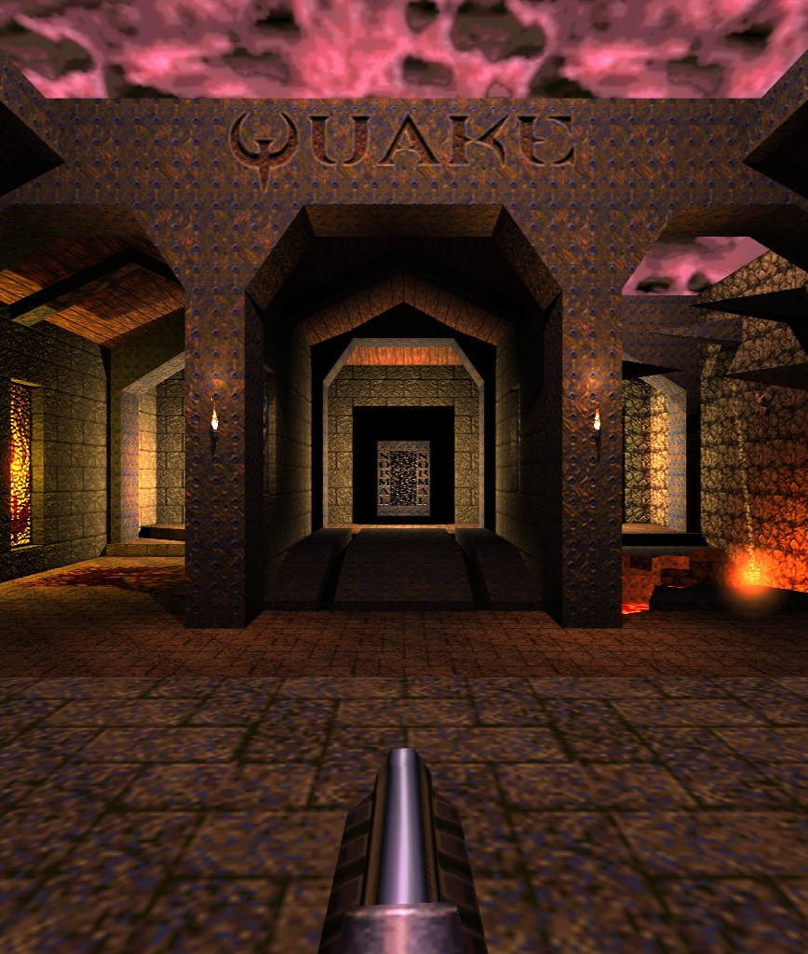
History
GPU’s used to be expensive and a non-consumer product
John Carmack pioneered 3D in video games through software rasterization

Slide 3
Quake Engine
Very fast
Heavily optimized and limited to use case
Uses BSP to only render a small portion of map
Most lighting and effects pre rendered
Uses palette for gradients and full screen post-processing

Slide 4

Pipeline
Model View Transform
Cull Faces
Lighting Calculations
Projection Transform
Div by W
To Screen Space
Follows general fixed pipeline of early GPU’s
Triangle Rasterization

Slide 5

Homogeneous Coordinates
Allows for simplification of calculations with transformation matrices
Matrices can be concatenated which results in one matrix multiplication per vertex
0
1

Slide 6
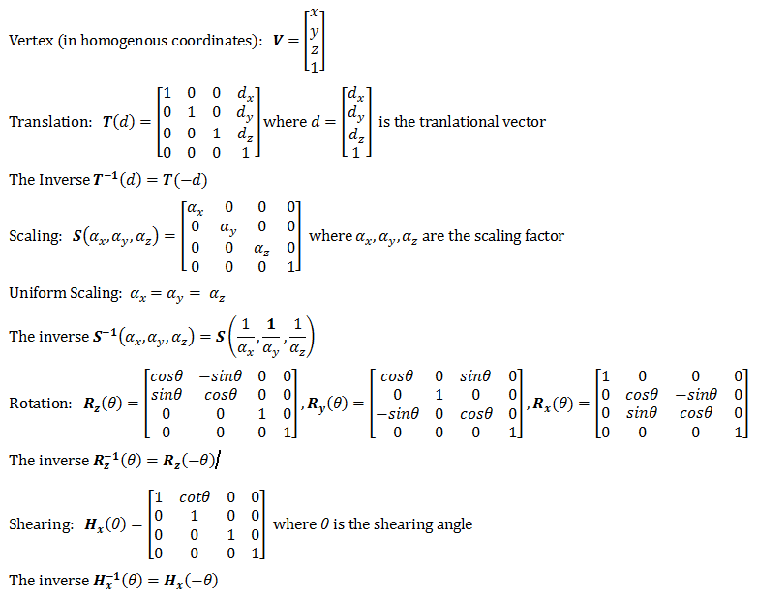
Affine Transformations

Slide 7
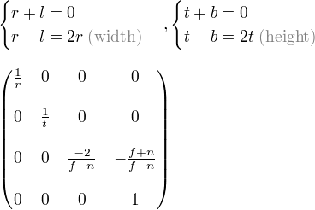
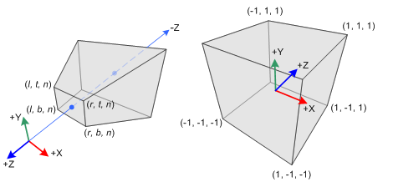
Projection Matrix
not affine
s = 1 / tan(fov * 0.5)
a = aspect ratio (width / height)
s/a
S

Slide 8
Modelview Transformation
Composed of affine transformations
World/Camera space
Could be combined with projection if not doing calculations in world space
Lighting and backface culling done in this space

Slide 9
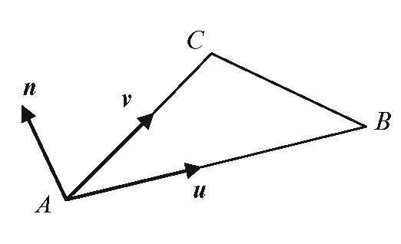
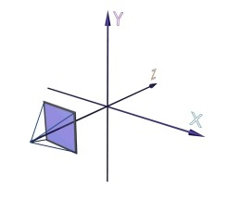
Backface Culling
If triangles are in counter-clockwise direction, we can take the cross product of u and v to get n
Since we are in camera space, if z > 0, the triangle must be facing away from the camera and can be culled

Slide 10
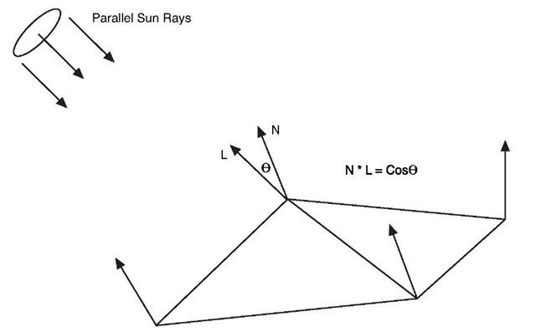
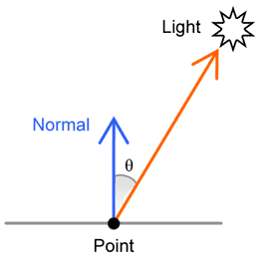
Lighting
Diffuse light = cos(theta) between face and direction to light

Slide 11
Projection Transform
Converts world coordinates to unit cube (except Z)
Stores form of Z in W (vertices no longer homogenous)
Space is still linear

Slide 12
Clipping
Faces clipped to unit cube in projection space
Faces outside are removed
Faces partially inside are clipped and form two new triangles with interpolated values.
Projection space is the best for clipping because visible vertices are bound to -1 to 1 and space is still linear.

Slide 13
W Divide
Transforms viewing cube to frustrum
Coordinates are homogenized (in theory; W keeps Z value for later because a 1 W isn’t useful anymore anyway)

Slide 14
Screen Space Transformation
Just maps -1 -> 1 to 0 -> [Screen Dimension]

Slide 15
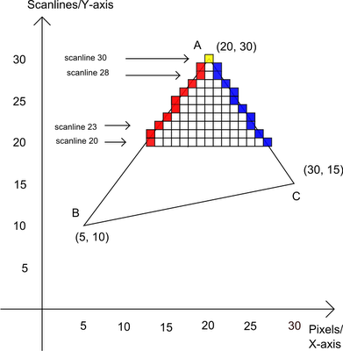
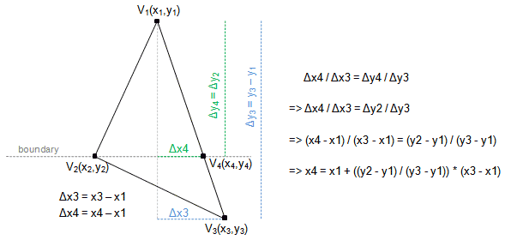
Triangle Rasterization
Fills triangles line by line
Implemented by traversing edges
Not true to GPU implementations which use barycentric coordinates (more parallel + other useful properties)

Slide 16
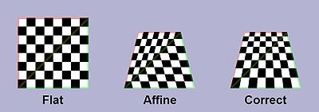
Value Interpolation
Values are interpolated linearly between the ends of two edges and then again between the edges
This is good enough for most properties but it is not correct
When interpolating textures the error is apparent

Slide 17
Perspective Correct Textures
The solution to this is to interpolate [u/w, v/w, 1/w]
Then u/w / 1/w = u
Can be done every couple steps to improve performance with less significant visual errors

